Slide 1

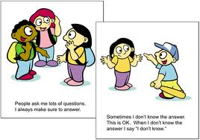
https://www.youtube.com/watch?v=vjlIYYbVIrI
Social Stories

Slide 2

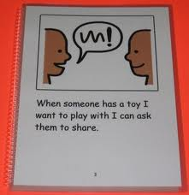
Social Stories
A social story is a simple story format that provides concrete
information to help a child understand and improve social skills
and behaviour. It is used to support
social misunderstanding
self awareness,
self calming
self management skills.
A social story addresses specific situations by teaching the child appropriate
behaviours and responses, for example:
Change/ transition from one class to another,
understanding unstructured times (lunch/play/break time)
personal hygiene (shower daily.)
Style and content vary according to the age of the child and the given event. It is an easy and effective way to teach children to handle problem situations in “appropriate ways”.

Slide 3

Social Stories
A social story can be used at home, at school, or in the community to teach or maintain social skills, daily living skills, or behaviour management skills.
The topic for a social story is determined by observing the child and gathering information related to the situation that presents problems.
When possible write the story with the child.
It must be read as often as needed and worked into
the child’s daily school/ home routine.
Remember its a tool to help support a child to understand what’s
appropriate.
Its only effective if used regularly and consistently.

Slide 4

Social Stories
So just imagine...
You are at home watching your favourite TV program. (Coronation street…EastEnders… Holby city!!)
Suddenly it’s interrupted by an urgent news flash of the Royal Family's wedding
You have been waiting all week to see what will happen next on your favourite show but now you’re suddenly in the middle of news that you think could have waited until later.

Slide 5
Despite disappointments now and then most of us have learned how to deal with life’s little changes,
BUT
what if you had not learned those skills?
What if situations like this threw you off every time they occurred?
Can a person learn how to deal with this type of challenge?

Slide 6
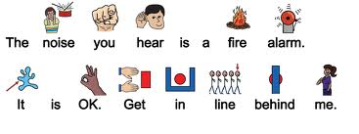
Social Stories
Children in our school have a range of additional needs, early trauma, communication
and interaction, autism, sensory, cognition and learning, developmental delay, as
such they have great difficulty dealing with unforeseen changes like the TV
episode and many other curves that life throws us.
They become extremely upset with any changes in routine.

Slide 7
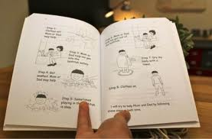
Purpose of a social story
To describe social situations and appropriate responses
correct a child’s responses to a social situation
in a non threatening manner
personalise instructions for a child
break goals into easy steps
teach routines for better retention and generalisation
help the child cope with both expected and unexpected changes
address a wide variety of problem behaviors (i.e.,aggression, fear, obsessions)
For the social story to be most effective, its important that the teacher,
Parents and child have an identical understanding of what behaviour is being targeted.

Slide 8
How many sentences/ pages/ how much information?
Choose the number of sentences to go on each page, according to the child level.
One to three sentences per page may be appropriate for some children however, if
the child is of a higher level, more sentences may be used.
To enable the child to understand the social story, you should address only one
concept per page, again depending on the child's cognitive skills.
Social stories can be written in book format, bound or placed in a notebook, they
can be written on poster board, cardboard, laminated paper, photographs, hand-
drawn illustrations, pictures or other visuals.
Some children are distracted by pictures or may have difficulty generalising from a
picture, its important you know and work with the child.

Slide 9
The four types of sentences
1. Descriptive – tells where situations occur, who is involved, what they are doing, and why.
"At breaktime there are many children playing with the ball."
2. Perspective – describes the reactions and feelings of the child and of other people.
"When I take the ball without asking, it makes the other children angry."
3. Directive – tells the child what to do.
"When I want to play with the ball, I will ask the other children first."
4. Control – after the social story is read, the child writes sentences to help him/her remember the information from the social story (this is optional).
The child may write, "It can make other children angry if I take the ball without asking."

Slide 10
Getting Started
Identify the behaviour you want to manage
Example
Billy struggles in social situations. He spends the majority of his school
day in the classroom with one: one support and an individual timetable.
Billy is not able to ask others for what he wants, sometimes when
he wants a toy another is playing with; he simply goes over and takes
it from the other child.
Betsy is in year 3 has a diagnosis of ASC (autism). She loves to study
different types of birds and is constantly talking to her peers about
birds even when they show no interest. Sometimes her conversations
about birds get her in trouble at school because she is totally unaware
of when it is inappropriate to engage in such conversations.

Slide 11
EXAMPLE
Billy’s Social Story
Page one
Every day I like to play with the toys in my classroom. (Descriptive)
Page two
This is a time to share and be with other children. (Perspective)
Page three
Sometimes a child is playing with a toy I want. (Perspective)
Page four
If I want that toy, I should ask first. I can say, "May I play with
that toy?" or "When you are finished with that toy, can I play with
it?" (Directive)
Page five
If the child says no, I can play with a different toy and wait until the
toy I want is available.(Directive)
Page six
When I play, I will try to share and have fun. (Directive)

Slide 12
What next.....
Putting the social story into practice
How to use a social story
Read the story to the child; add the social story to structured periods of the day. Briefly
explain the importance of a social story.
Discuss with Billy the importance of sharing – making friends, getting
along.
Read through the story once or twice and model the desired behaviour (when necessary)
After reading the social story on sharing, the adult plays with one of
Billy’s favourite toys. Billy is encouraged to ask for the toy and
Respond appropriately.
Read the story just prior to a situation in which the problem behaviour is likely to
occur again if appropriate. Billy’s problem with toy grabbing occurs mainly at break
time – read the social story right before break each day.
Provide opportunities for the child to read the Social story with other children or
adults.

Slide 13
Create a schedule for the child in which the story is read at the same time and in
the same way each time (if necessary).
Read the story just prior to a situation in which the problem behaviour is likely to
occur again if appropriate.
Billy’s problem with toy grabbing occurs mainly at break time – read the social
story right before break each day.
Provide opportunities/ alternatives for the child to read the Social story with other
children or adults.

Slide 14
Is it working?
Observe:
If the child has not responded to the social story after an appropriate length of
time (again this varies), review the social story and how it has been used. If
modifications are needed, change only one aspect of the social story at a time.
Change when the story is read; do not change the words of the story or who
reads the story. This helps determine what aspect of the social story works
and does not work with the child.
If Billy’s social story is read to him before break, he may become too excited
and be unable to listen to the story. So instead read the social story at a
different time during the day.
What to do next:
Fade the social story, extend the time between readings or having the child
read the story independently.
Work with the child to identify new social skills to address.
Create new social stories that address other inappropriate or worrying
behaviours.

Slide 15

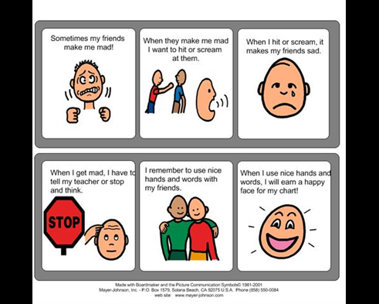
Please Be
Be consistent
Keep it simple
Talk it through
Act it out

