Slide 1
Forest School and Risky Play:
Promoting Holistic Development
The world is dangerous.
To prevent disease, we give children small doses of the illness to build their body’s resilience.
In the same way, Forest School vaccinates children against poor development by exposing them to small doses of risk, helping them build resilience to significant risks and promoting positive development in all areas of the child’s personality.

Slide 2
Introduction
‘Risk’ is the exposure to danger, both physical and emotional, and the Forest School ethos promotes the exposure of learners to risk in an appropriate, controlled and supportive environment. The danger is always limited by thorough risk management, but is real enough to be perceived by the learners for very good reasons…
By experiencing a risk, children are prompted with an emotional reaction – Do I do it? Am I strong enough? Brave enough? Determined enough? They could go for it and succeed, prompting great boosts to self-esteem and independence. They could try to make the challenge easier or seek help to complete it, developing problem solving and team-working skills. Or they could choose not too do it at all, developing an awareness of risk and the confidence to choose how to handle it. All of these also promote in the child an awareness of themselves and their abilities, which is vital for keeping themselves safe in the future.
The Forest School environment is rich in these experiences and, throughout a series of sessions, will develop many skills and abilities. Because it is so rich in challenging opportunities, learners develop holistically, improving across their emotional, intellectual, physical, spiritual and social intelligence.
This document provides a number of examples of how risk taking in Forest School can promote holistic development. Please explore our examples or click here to see some links to further reading.

Slide 3
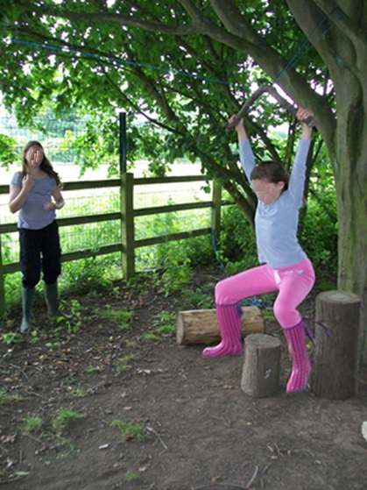
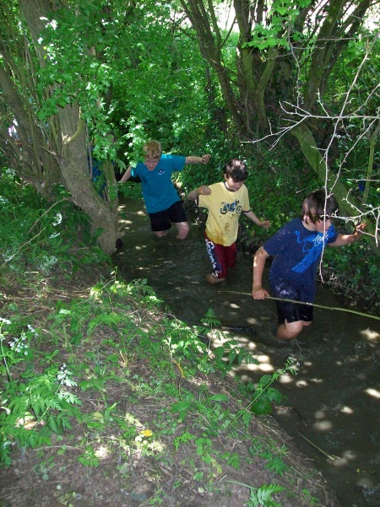
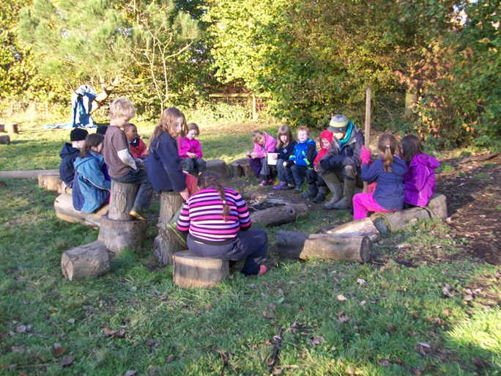
How to Explore this Document
Back to beginning
Further Reading
We have chosen three examples of ‘risky play’ during Forest School to help explain its benefits. Click on one of the photos below to start exploring.
For each picture we have tried to explain the benefit of the activity to the child and how the opportunity has been controlled/promoted by Forest School.
Physical Risk
Emotional Risk
Social Risk

Slide 4
Back to Menu
Physical Risk - Adventurous play inevitably involves some physical risk - from simply falling over to falling from a tree. These risks benefit the child by:
Becoming aware of small risks they are better able to assess larger ones, keeping them safer in the long run.
Building resilience to small discomforts and failures promotes a ‘can-do’ attitude and prevents fear of failure.
Helping them to test their limits so they do not exceed their actual physical abilities.
Promoting an exciting, active lifestyle we sow the seeds for a health conscious future.
Developing core strength, balance and co-ordination.

Slide 5
Back to Menu
Promotion and Control of Physical Risk
All Forest School sites, activities and equipment has been extensively risk assessed which is updated constantly. Anything posing serious harm has been removed or controlled. Sites are checked before every session and Forest Leaders are all trained in the safe use of tools, fire protocols and Outdoor Paediatric First Aid.
In Forest School, no-one is forced to do an activity or face up to a risk. It is child-led, meaning pupils can chose what they do or don’t do. The result of this is a self-differentiated environment – to some, just staying upright in the mud is a risky challenge which pushes them to the limit. To others, using an axe to make another tool is very scary, so their concentration and nerve is tested. The point is the child makes this distinction, not the adult who has pre-decided ideas of what the child should or shouldn’t do.
Forest School builds up to risks by starting small, with achievable challenges. Progression is planned for each group and each individual, so challenges are presented at the correct level.
The social environment of Forest School promotes the discussion of risk – both beforehand, by pupils planning an activity, and by reflecting on an experience to see what has been learned.

Slide 6
Back to Menu
Emotional Risk – Children don’t enjoy feeling embarrassed, vulnerable or scared, but in the correct environment these feelings can be nurtured into positive outcomes. For example:
Peer pressure is ever present. By exposing children to it in a safe, inclusive environment, they build the confidence to decide for themselves, to face the challenge or be strong enough to resist (see photo and comment).
By sharing food, building group dens, playing in teams, Forest School builds a communal atmosphere that better allows individuals to express themselves without fear of reprisal.
Similarly, the open-ended nature of Forest School removes the concept of a ‘wrong answer’, an individual’s ideas and opinions can be valued and praised.
These boys challenged each other to walk through the deepest part of the stream, past the ‘tree of death’. They began hesitantly, afraid of falling and everyone laughing but equally scared of chickening out. Elated, they completed the task and went on the do so three more times.

Slide 7
Back to Menu
Promotion and Control of Emotional Risk
Like other types of risk, every attempt is made to remove chances of lasting harm to occur through emotional turmoil in Forest School. For example; individuals are not over-challenged so they can avoid significant failure, they are not made to take part in any activity so they can avoid embarrassment or challenge that they are not ready for, and they are encouraged to express themselves in a way that suits them, not in a way that suits the adults present.
During play there is the chance of negative emotions to be experienced – but these are not negative experiences. By exposing children to these emotions in small doses, in a controlled and supportive atmosphere, they build resilience to them and learn how to control them, making them better prepared for the larger risks of adolescence and adulthood.
Emotions are discussed in Forest School, which much praise and promotion of positive experiences and outcomes. For example, an individual determined to climb higher than he/she did last week is highlighted to the group for their positive attitude towards a difficult task, thus maximising the feeling of reward and boosting self-esteem.

Slide 8

Back to Menu
Social Risk – Making friends and falling out is a big part of childhood. Feeling accepted or rejected from a group can have massive implications on self-image. Therefore children must learn to positively interact with others, despite the risks of negative feelings.
By feeling left out, treated unfairly by their peers or falling out during play, children experience the outcomes of poor social interaction. By feeling it themselves it becomes personally significant. They are then necessitated to learn how to behave in a way that avoids conflict or are better prepared to deal with conflict positively.
By experiencing these feelings pupils are also better able to develop a sense of empathy, as they don’t want to make someone else feel that way, helping them to avoid upsetting others or to see their point of view.
Following a class-wide fall out, these pupils came together to discuss the reasons for the argument and the best way forward. They used a talking stick to encourage a fair discussion and listened to everyone’s input.

Slide 9
Back to Menu
Promotion and Control of Social Risk
These kinds of risks are ever present, however in the classroom developing these important skills are not often a focus.
The risk of significant negative outcomes are limited through the creation of a positive social atmosphere. Many activities are communal and involve sharing and teamwork, such as campfire cooking, building dens and team games. Time is made in every Forest School session to discuss children’s experiences, giving time and space for reflection on these to promote social learning. All people are considered equal and efforts are made to involve each individual to develop the sense that everyone is part of one big team.
Forest Leaders are always observing pupils in Forest School and can help if appropriate, but they will not do the pupil’s learning for them. For example, arguing children are observed, not interfered with. This gives the children the chance to think, feel, try out some solutions, and eventually solve the problem themselves – a much richer learning experience than an adult telling them what to do. Of course an option the children can explore is seeking adult help, but generally they do this less and less as they develop this social independence. (Please note: adults would intervene if significant emotional damage became more likely or if conflict was recurrent.)

Slide 10
Further Reading on Risky Play and Holistic Development
Risk Competence: http://www.thempra.org.uk/downloads/Eichsteller%20&%20Holthoff%20-%20Risk%20Competence.pdf
Risk and Play – A Literature Review: http://www.playday.org.uk/media/2661/risk_and_play___a_literature_review.pdf
Risky Play Prepares Kids for Life: http://www.theguardian.com/society/2008/aug/06/children.play
http://www.playengland.org.uk
http://www.forestschoolassociation.org/
Back to Menu

